Slide 1
CSE 403 Computer Networks
(3+0 : 3 Credits)
Assoc.Prof.Dr.Yalçın ÇEBİ
Dokuz Eylül University
Dept.of Computer Engineering
CSE 403 Computer Networks

Slide 2
PART 1
INTRODUCTION
CSE 403 Computer Networks

Slide 3
Computer Network
Interconnected collection of autonomous computers
If one computer can forcibly start, stop, or control another one, the computers are not autonomous.
CSE 403 Computer Networks

Slide 4
Distributed System
In a distributed system, the existence of multiple autonomous computers is transparent to the user.
The user is not aware that there are multiple processors; it looks like a virtual uniprocessor.
It is a software system built on top of a network.
CSE 403 Computer Networks

Slide 5
Uses of Computer Networks
Resource Sharing: All programs, equipment, and data is available to anyone on the network withour regard to physical location of the resource and the user.
CSE 403 Computer Networks

Slide 6
Uses of Computer Networks (cont’d)
High Reliability: Alternative sources of supply. Replication of files on two or three machines, presence of multiple CPU’s
CSE 403 Computer Networks

Slide 7
Uses of Computer Networks (cont’d)
Saving Money: Small computers have amuch better price/performance ratio than large ones.
  Mainframes are ten times faster than PC’s, but they cost thousand time more.
CSE 403 Computer Networks

Slide 8
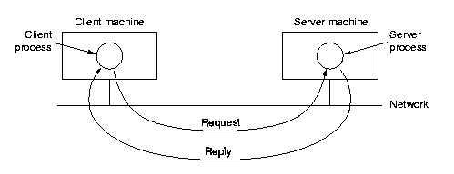
Client-Server Model
CSE 403 Computer Networks

Slide 9
Network Types
Local Area Networks (LAN)
Metropolitan Area Networks (MAN)
Wide Area Networks (WAN)
Wireless Networks
Internetworks
CSE 403 Computer Networks

Slide 10
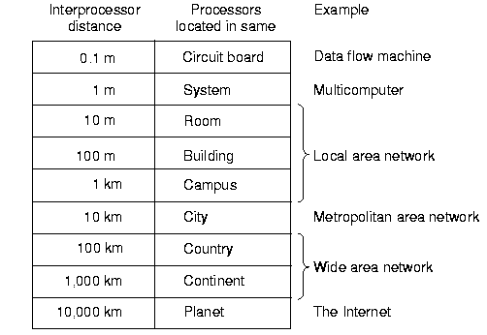
Classification of Interconnected Processors by Scale
CSE 403 Computer Networks

Slide 11
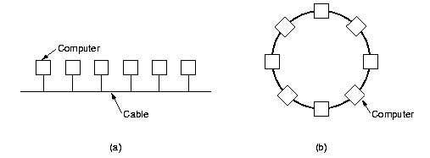
Local Area Networks (LANs)
Two Broadcast Networks. (a) Bus, (b) Ring.
CSE 403 Computer Networks

Slide 12
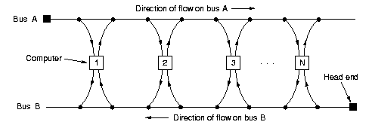
Metropolitan Area Networks
Distributed Queue Dual Bus (QDBD) architecture
CSE 403 Computer Networks

Slide 13
Wide Area Networks
WAN spans a large geographical area, often a country or continent.
It contains a collection of machines intended for running user programs. These machines are called hosts.
The hosts are connected by a communication subnet.
CSE 403 Computer Networks

Slide 14
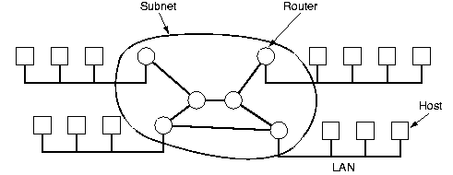
Wide Area Networks
Relation between hosts and subnet
CSE 403 Computer Networks

Slide 15
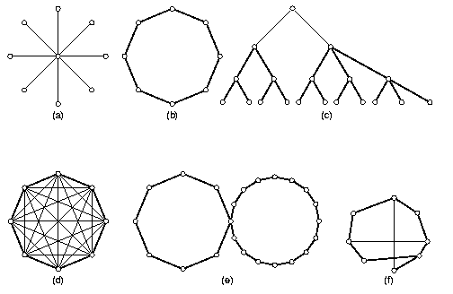
Some Network Topologies
Possible topologies for a point-to-point subnet
(a)Star, (b)Ring, (c)Tree, (d)Complete, (e)Intersecting Rings, (f)Irregular.
CSE 403 Computer Networks

Slide 16
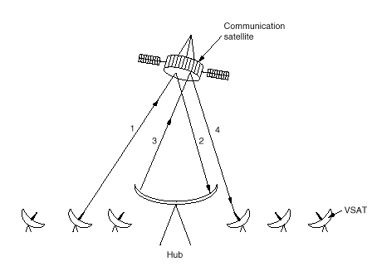
VSAT’s Using a HUB
CSE 403 Computer Networks

Slide 17
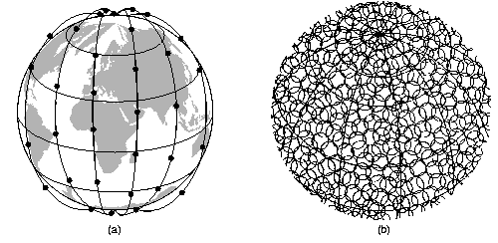
Wireless Networks
Iridium Project (a)The Iridium satellites around the six necklaces around the earth, (b) 1628 moving cells cover the earth
CSE 403 Computer Networks

Slide 18
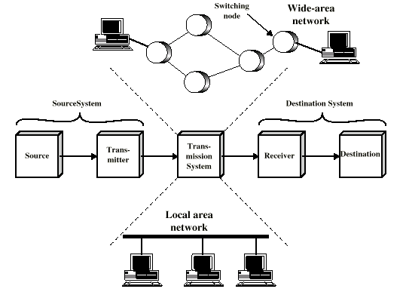
Simplified Network Models
CSE 403 Computer Networks

Slide 19
How do Computer Networks and Internets Operate?
Network: system for connecting computer using a single transmission technology
Internet: set of networks connected by routers that are configured to pass traffic among any computers attached to networks in the set
CSE 403 Computer Networks

Slide 20
How do Computer Networks and Internets Operate? (cont’d)
Data transmission - media, data encoding
Packet transmission - data exchange over a network
Internetworking - universal service over a collection of networks
Network applications - programs that use an internet
CSE 403 Computer Networks

Slide 21
Explosive growth
New phenomenon - now, networks are an important part of everyday activities
Business
Home
Government
Education
CSE 403 Computer Networks

Slide 22
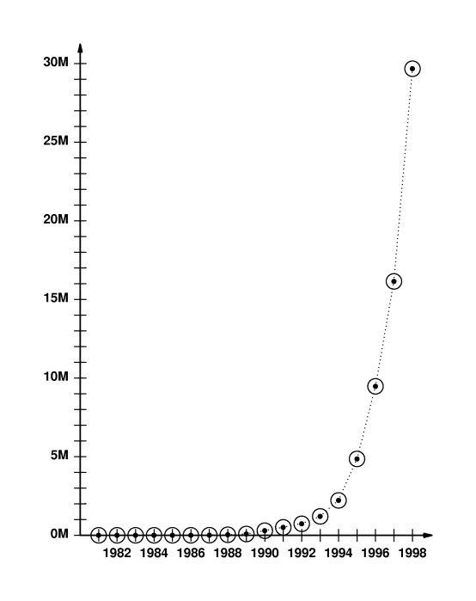
Explosive growth (cont’d)
Global Internet growing exponentially
Initially a research project with a few dozen sites
Today, millions of computers and hundreds of networks world-wide
CSE 403 Computer Networks

Slide 23
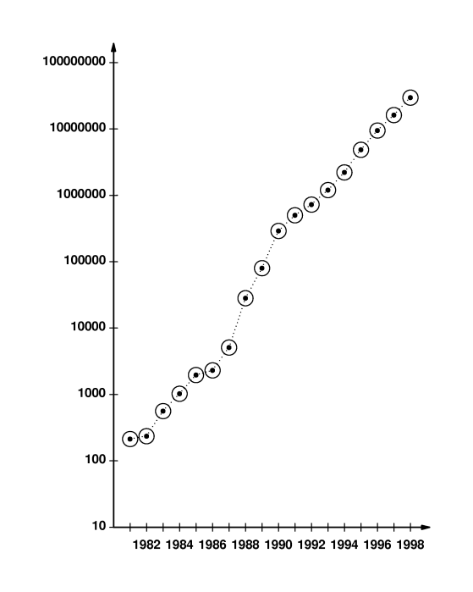
Internet
Roots in military network called Arpanet
Fundamental changes from centralized to distributed computing
Incorporated features for reliability and robustness
- Multiple links
- Distributed routing
CSE 403 Computer Networks

Slide 24
Internet (cont’d)
Ethernet made local networking feasbile
TCP/IP protocol made internetworking possible
  Developed after Arpanet
  Switchover occurred in 1983
Exponential growth - doubling every 18 months
CSE 403 Computer Networks

Slide 25
Economic impact
Large industry has grown around:
  Networking hardware
  Computers
  Software
Companies must integrate planning, implementation, management and upgrade
CSE 403 Computer Networks

Slide 26
Complexity
Computer networking is complex
  Many different hardware technologies
  Many different software technologies
  All can be interconnected in an internet
  No underlying theory
CSE 403 Computer Networks

Slide 27
Terminology
Terminology can be confusing
  Industry redefines or changes terminology from academia
  New terms invented all the time
CSE 403 Computer Networks

Slide 28
PART 2
TRANSMISSION MEDIA
CSE 403 Computer Networks

Slide 29
Basic Idea
Encode data as energy and transmit energy
Decode energy at destination back into data
Energy can be electrical, light, radio, sound, ...
Each form of energy has different properties and requirements for transmission
CSE 403 Computer Networks

Slide 30
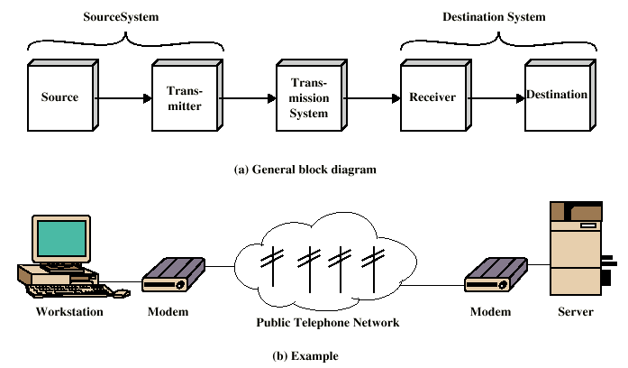
Transmission
Simplified Communications Model
CSE 403 Computer Networks

Slide 31
Transmission media
Transmitted energy is carried through some sort of medium
Transmitter encodes data as energy and transmits energy through medium
Requires special hardware for data encoding
Requires hardware connection to transmission medium
CSE 403 Computer Networks

Slide 32
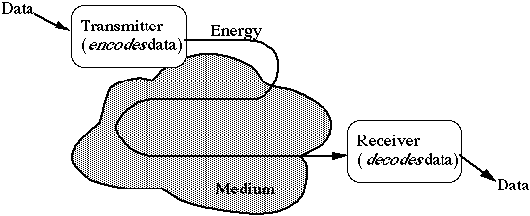
Transmission media (cont’d)
Media can be copper, glass, air, ...
CSE 403 Computer Networks

Slide 33
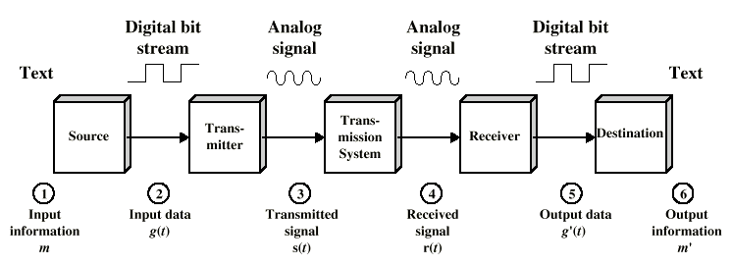
Data Communications
Simplified Data Communications Model
CSE 403 Computer Networks

Slide 34
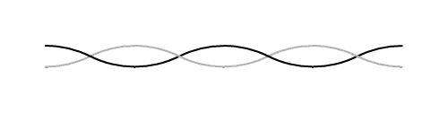
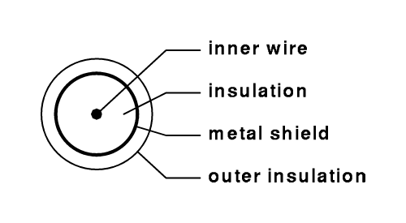
Copper wires
Twisted pair uses two wires
Coaxial cable includes shield for improved performance
CSE 403 Computer Networks

Slide 35
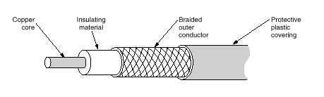
Co-axial Cable
CSE 403 Computer Networks

Slide 36
Glass fibers
Thin glass fiber carries light with encoded data
Plastic jacket allows fiber to bend (some!) without breaking
Fiber is very clear and designed to reflect light internally for efficient transmission
CSE 403 Computer Networks

Slide 37

Glass fibers (cont’d)
Light emitting diode (LED) or laser injects light into fiber
Light sensitive receiver at other end translates light back into data
CSE 403 Computer Networks

Slide 38
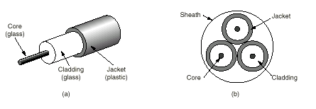
Fiber Cable
CSE 403 Computer Networks

Slide 39
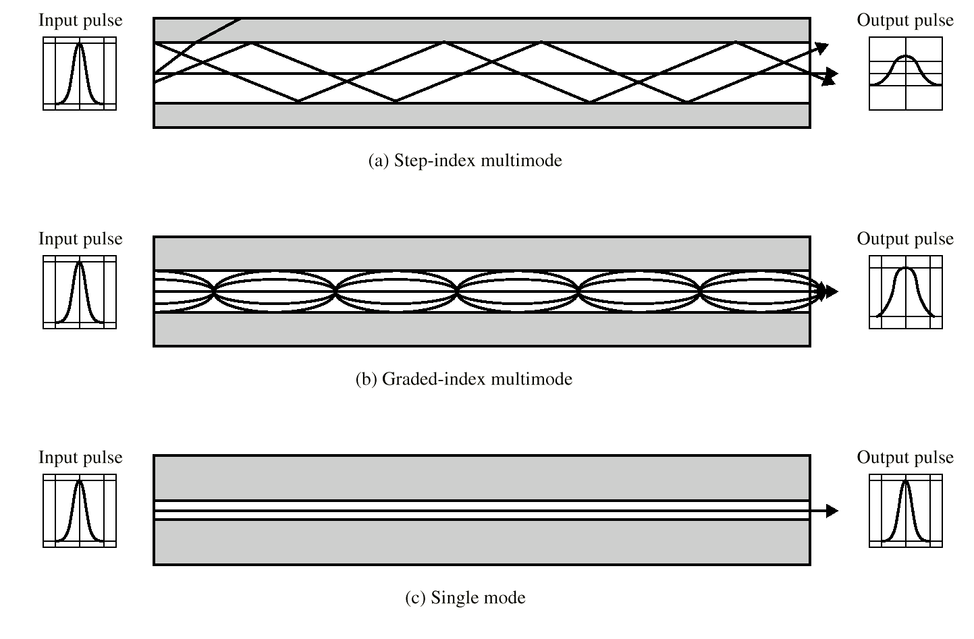
Optical Fiber Transmission Modes
CSE 403 Computer Networks

Slide 40
Radio
Data transmitted using radio waves
Energy travels through the air rather than copper or glass
Conceptually similar to radio, TV, cellular phones
Can travel through walls and through an entire building
CSE 403 Computer Networks

Slide 41
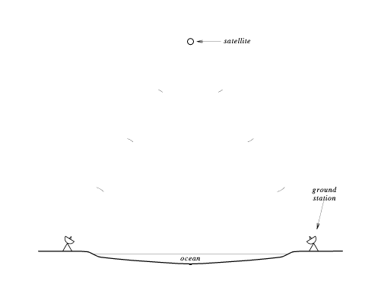
Radio (cont’d)
Can be long distance or short distance
  Long distance with satellite relay
  Short distance - wireless computer network
CSE 403 Computer Networks

Slide 42
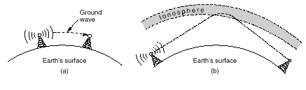
Radio (cont’d)
(a) In the VLF, VF and MF bands, radio waves follow the curvature of the earth, (b) In the HF, they bounce off the ionosphere.
CSE 403 Computer Networks

Slide 43
Microwave
High frequency radio waves
Unidirectional, for point-to-point communication
Antennas mounted on towers relay transmitted data
CSE 403 Computer Networks

Slide 44
Infrared
Infrared light transmits data through the air
Similar to technology used in TV remote control
Can propagate throughout a room (bouncing off surfaces), but will not penetrate walls
Becoming common in personal digital assistants (PDAs) and portable computers
CSE 403 Computer Networks

Slide 45
Laser
Unidirectional, like microwave
Higher speed than microwave
Uses laser transmitter and photo-sensitive receiver at each end
Point-to-point, typically between buildings
Can be adversely affected by weather
CSE 403 Computer Networks

Slide 46
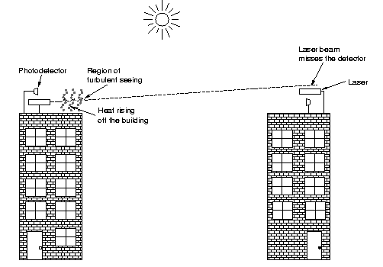
Laser (cont’d)
CSE 403 Computer Networks

Slide 47
Choosing a medium
Copper wire is mature technology, rugged and inexpensive; maximum transmission speed is limited
Glass fiber:
  Higher speed
  More resistant to electro-magnetic interference
  Spans longer distances
  Requires only single fiber
  More expensive; less rugged
CSE 403 Computer Networks

Slide 48
Choosing a medium (cont’d)
Radio and microwave don't require physical connection
Radio and infrared can be used for mobile connections
Laser also does not need physical connection and supports higher speeds
CSE 403 Computer Networks

Slide 49
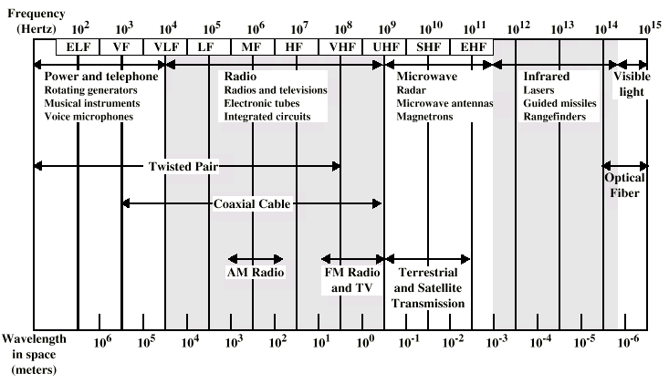
Electromagnetic Spectrum for Telecommunications
CSE 403 Computer Networks

Slide 50
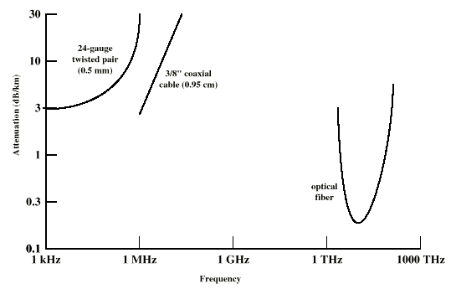
Attenuation to Typical Guided Media
CSE 403 Computer Networks

Slide 51
Media in use at DEÜ
Copper/fiber for long-distance connection to Internet and between campuses
Fiber within and between buildings
Copper within buildings
CSE 403 Computer Networks

